Slide 1
Lecture 12
More Bellman-Ford, Floyd-Warshall,
and Dynamic Programming!

Slide 2
WiCS Speed Mentoring Night!

Slide 3
Announcements
HW5 due Friday
The midterm was hard!
But I think you guys did great!
Grades and solutions released soon…

Slide 4
Important feedback from Piazza

Slide 5
Anakin the Adversarial Aardvark

Slide 6
Today
Bellman-Ford continued
Bellman-Ford is a special case of Dynamic Programming!
What is dynamic programming?
Warm-up example: Fibonacci numbers
Another example:
Floyd-Warshall Algorithm

Slide 7
Recall
Weights on edges represent costs.
The cost of a path is the sum of the weights along that path.
A shortest path from s to t is a directed path from s to t with the smallest cost.
The single-source shortest path problem is to find the shortest path from s to v for all v in the graph.
A weighted directed graph:
u
s
3
32
1
5
1
This is a path from s to t of cost 22.
b
v
13
a
21
2
16
t
This is a path from s to t of cost 10. It is the shortest path from s to t.

Slide 8
Last time
Dijkstra’s algorithm!
Bellman-Ford algorithm !
Both solve single-source shortest path in weighted graphs.
u
s
3
32
1
5
1
We sped through the Bellman-Ford algorithm so let’s do that now in a bit more detail.
b
v
13
a
21
2
16
t

Slide 9


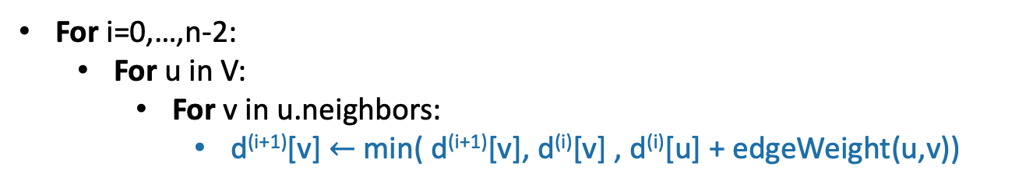





Bellman-Ford
=
Gates
0
How far is a node from Gates?
$$∞$$
1
Gates Packard CS161 Union Dish
CS161
d⁽⁰⁾
0
$$∞$$
$$∞$$
$$∞$$
$$∞$$
d⁽¹⁾
1
Packard
d⁽²⁾
4
$$∞$$
d⁽³⁾
22
$$∞$$
Union
d⁽⁴⁾
WHOOPS! The pseudocode was messed up during lecture! It’s still a bit messed up since d^{(i+1)} might not get initialized before it’s used – just assume that everything is initialized to Infinity. (We’ll re-write the pseudocode later in the lecture so it won’t matter too much.)
25
i=1
20
For i=0,…,n-2:
For u in V:
For v in u.neighbors:
d^{(i+1)}[v] $←$min( d^{(i+1)}[v], d^{(i)}[v] , d^{(i)}[u] + edgeWeight(u,v))
Dish
$$∞$$

Slide 10


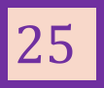
Bellman-Ford
Gates
0
How far is a node from Gates?
$$∞$$
1
Gates Packard CS161 Union Dish
CS161
d⁽⁰⁾
0
$$∞$$
$$∞$$
$$∞$$
$$∞$$
d⁽¹⁾
1
0
1
$$∞$$
$$∞$$
25
Packard
d⁽²⁾
4
$$1$$
d⁽³⁾
22
$$∞$$
Union
d⁽⁴⁾
25
i=1
20
For i=0,…,n-2:
For u in V:
For v in u.neighbors:
d^{(i+1)}[v] $←$min( d^{(i+1)}[v], d^{(i)}[v] , d^{(i)}[u] + edgeWeight(u,v))
Dish
$$25$$

Slide 11



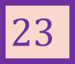
Bellman-Ford
Gates
0
How far is a node from Gates?
$$2$$
1
Gates Packard CS161 Union Dish
CS161
d⁽⁰⁾
0
$$∞$$
$$∞$$
$$∞$$
$$∞$$
d⁽¹⁾
1
0
1
$$∞$$
$$∞$$
25
Packard
d⁽²⁾
0
1
2
45
23
4
$$1$$
d⁽³⁾
22
$$45$$
Union
d⁽⁴⁾
25
i=1
20
For i=0,…,n-2:
For u in V:
For v in u.neighbors:
d^{(i+1)}[v] $←$min( d^{(i+1)}[v], d^{(i)}[v] , d^{(i)}[u] + edgeWeight(u,v))
Dish
$$23$$

Slide 12

Bellman-Ford
Gates
0
How far is a node from Gates?
$$2$$
1
Gates Packard CS161 Union Dish
CS161
d⁽⁰⁾
0
$$∞$$
$$∞$$
$$∞$$
$$∞$$
d⁽¹⁾
1
0
1
$$∞$$
$$∞$$
25
Packard
d⁽²⁾
0
1
2
45
23
4
$$1$$
d⁽³⁾
0
1
2
6
23
22
$$6$$
Union
d⁽⁴⁾
25
i=1
20
For i=0,…,n-2:
For u in V:
For v in u.neighbors:
d^{(i+1)}[v] $←$min( d^{(i+1)}[v], d^{(i)}[v] , d^{(i)}[u] + edgeWeight(u,v))
Dish
$$23$$

Slide 13
Bellman-Ford
Gates
0
How far is a node from Gates?
$$2$$
1
Gates Packard CS161 Union Dish
CS161
d⁽⁰⁾
0
$$∞$$
$$∞$$
$$∞$$
$$∞$$
d⁽¹⁾
1
0
1
$$∞$$
$$∞$$
25
Packard
d⁽²⁾
0
1
2
45
23
4
$$1$$
d⁽³⁾
0
1
2
6
23
22
$$6$$
Union
d⁽⁴⁾
0
1
2
6
23
25
These are the final distances!
i=1
20
For i=0,…,n-2:
For u in V:
For v in u.neighbors:
d^{(i+1)}[v] $←$min( d^{(i+1)}[v], d^{(i)}[v] , d^{(i)}[u] + edgeWeight(u,v))
Dish
$$23$$

Slide 14


Interpretation of d^{(i)}
Gates
0
$$2$$
1
d^{(i)}[v] is equal to the cost of the shortest path between s and v with at most i edges.
CS161
1
Packard
Gates Packard CS161 Union Dish
$$1$$
4
d⁽⁰⁾
0
$$∞$$
$$∞$$
$$∞$$
$$∞$$
22
$$6$$
d⁽¹⁾
0
1
$$∞$$
$$∞$$
25
Union
d⁽²⁾
0
1
2
45
23
25
d⁽³⁾
0
1
2
6
23
20
d⁽⁴⁾
0
1
2
6
23
Dish
$$23$$

Slide 15
Why does Bellman-Ford work?
Inductive hypothesis:
d^{(i)}[v] is equal to the cost of the shortest path between s and v with at most i edges.
Conclusion:
d^{(n-1)}[v] is equal to the cost of the shortest path between s and v with at most n-1 edges.
Do the base case and inductive step!

Slide 16
Aside: simple paths Assume there is no negative cycle.
Then there is a shortest path from s to t, and moreover there is a simple shortest path.
A simple path in a graph with n vertices has at most n-1 edges in it.
So there is a shortest path with at most n-1 edges
s
-2
v
10
t
2
-5
x
y
This cycle isn’t helping. Just get rid of it.
3
s
u
“Simple” means that the path has no cycles in it.
Can’t add another edge without making a cycle!
t
v

Slide 17
Why does it work?
Inductive hypothesis:
d^{(i)}[v] is equal to the cost of the shortest path between s and v with at most i edges.
Conclusion:
d^{(n-1)}[v] is equal to the cost of the shortest path between s and v with at most n-1 edges.
If there are no negative cycles, d^{(n-1)}[v] is equal to the cost of the shortest path.
Notice that negative edge weights are fine. Just not negative cycles.

Slide 18
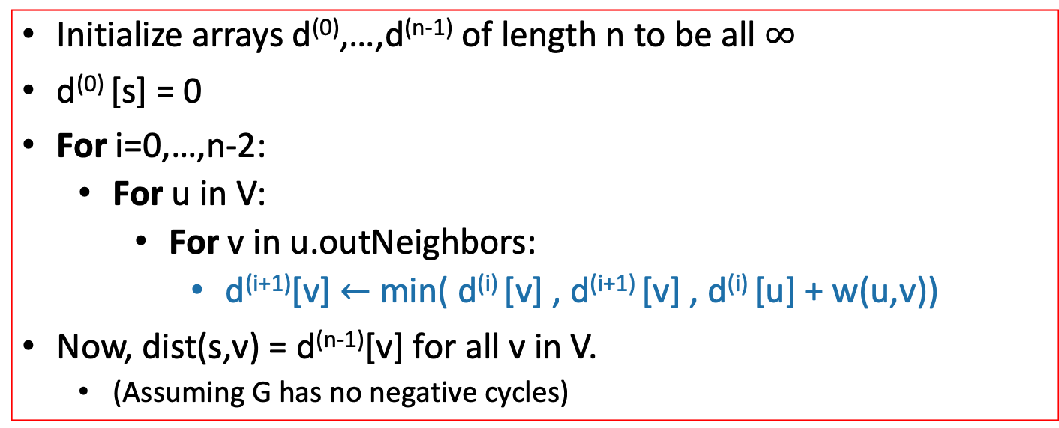
Bellman-Ford* algorithm
G = (V,E) is a graph with n vertices and m edges.
Bellman-Ford*(G,s):
Initialize arrays d⁽⁰⁾,…,d^{(n-1)} of length n to be all $∞$
d⁽⁰⁾ [s] = 0
For i=0,…,n-2:
For u in V:
For v in u.outNeighbors:
d^{(i+1)}[v] $←$min( d^{(i)} [v] , d^{(i+1)} [v] , d^{(i)} [u] + w(u,v))
Now, dist(s,v) = d^{(n-1)}[v] for all v in V.
(Assuming G has no negative cycles)
Here, Dijkstra picked a special vertex u – Bellman-Ford will just look at all the vertices u.
*Slightly different than some versions of Bellman-Ford…but this way is pedagogically convenient for today’s lecture.

Slide 19
We can simplify the pseudocode a bit
This will be useful later…

Slide 20
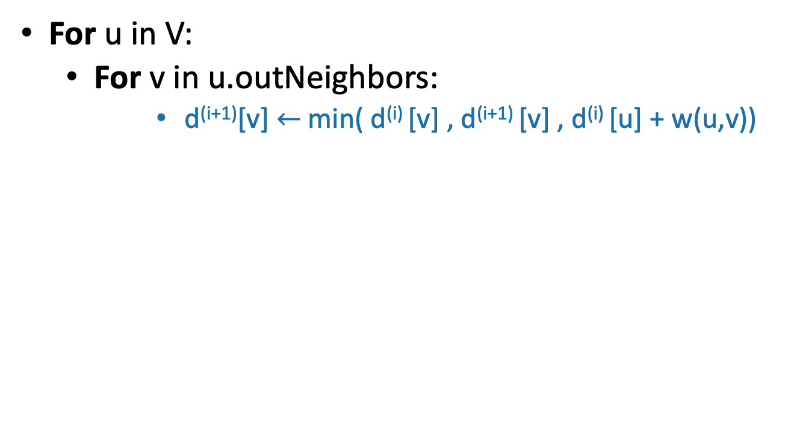
One step of Bellman-Ford
What will happen to z if we run these for-loops?
For u in V:
For v in u.outNeighbors:
d^{(i+1)}[v] $←$min( d^{(i)} [v] , d^{(i+1)} [v] , d^{(i)} [u] + w(u,v))
2
x
3
8
z
1
3
y

Slide 21
One step of Bellman-Ford
What will happen to z if we run these for loops?
For u in V:
For v in u.outNeighbors:
d^{(i+1)}[v] $←$min( d^{(i)} [v] , d^{(i+1)} [v] , d^{(i)} [u] + w(u,v))
2
x
3
4
z
1
3
y

Slide 22
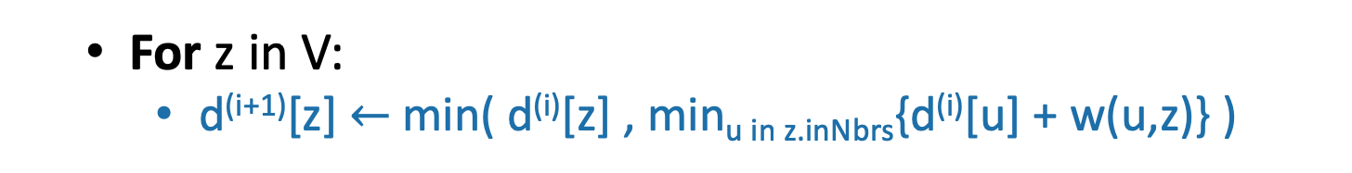
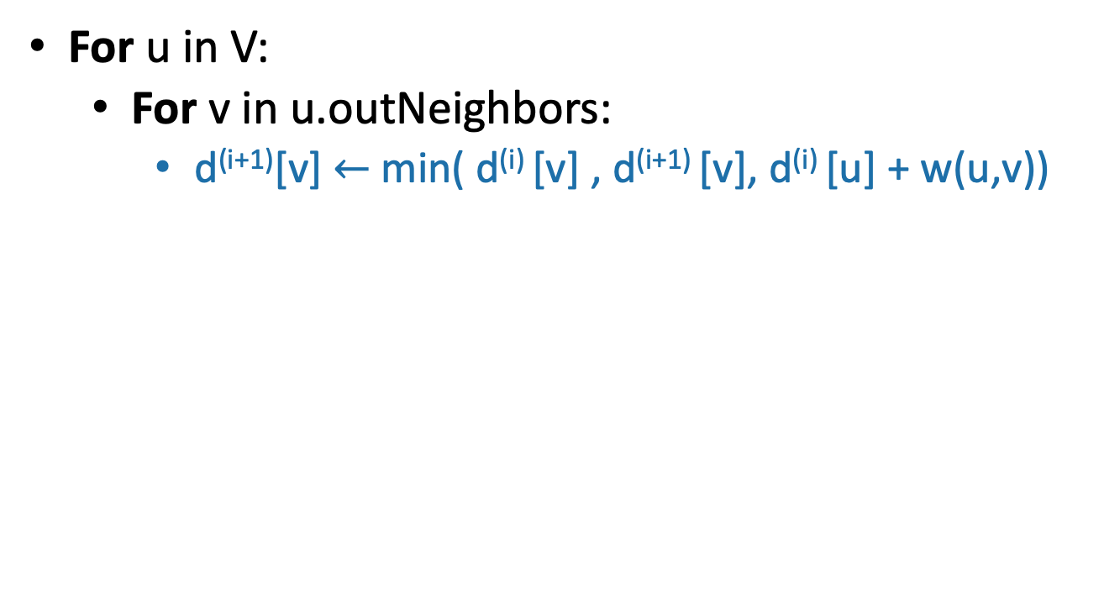
One step of Bellman-Ford
For u in V:
For v in u.outNeighbors:
d^{(i+1)}[v] $←$min( d^{(i)} [v] , d^{(i+1)} [v], d^{(i)} [u] + w(u,v))
Each vertex z finds the in-neighbor u so that d^{(i)} [u] + w(u,z) is smallest and goes with that.
(Unless z chooses not to update).
So we can equivalently write:
2
x
3
z
4
3
y
1
For z in V:
d^{(i+1)}[z] $←$min( d^{(i)}[z] , min_{u in z.inNbrs}{d^{(i)}[u] + w(u,z)} )

Slide 23
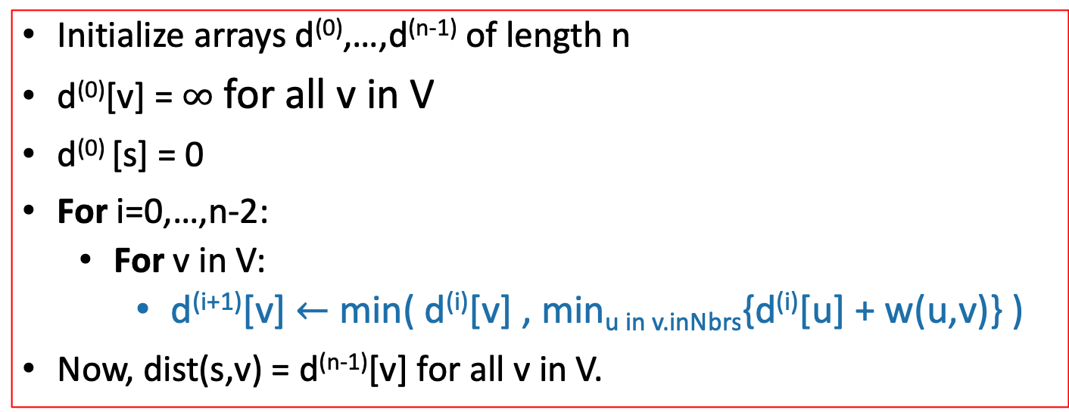
Bellman-Ford* algorithm
G = (V,E) is a graph with n vertices and m edges.
Bellman-Ford*(G,s):
Initialize arrays d⁽⁰⁾,…,d^{(n-1)} of length n
d⁽⁰⁾[v] = $∞$ for all v in V
d⁽⁰⁾ [s] = 0
For i=0,…,n-2:
For v in V:
d^{(i+1)}[v] $←$min( d^{(i)}[v] , min_{u in v.inNbrs}{d^{(i)}[u] + w(u,v)} )
Now, dist(s,v) = d^{(n-1)}[v] for all v in V.
*Slightly different than some versions of Bellman-Ford…but this way is pedagogically convenient for today’s lecture.

Slide 24
Note on implementation
Don’t actually keep all n arrays around.
Just keep two at a time: “last round” and “this round”
Gates Packard CS161 Union Dish
d⁽⁰⁾
0
$$∞$$
$$∞$$
$$∞$$
$$∞$$
d⁽¹⁾
0
1
$$∞$$
$$∞$$
25
d⁽²⁾
0
1
2
45
23
d⁽³⁾
0
1
2
6
23
Only need these two in order to compute d⁽⁴⁾
d⁽⁴⁾
0
1
2
6
23

Slide 25
Bellman-Ford take-aways
Running time is O(mn)
For each of n rounds, update m edges.
Works fine with negative edges.
Does not work with negative cycles.
But it can detect negative cycles!
(We waved our hands at this last time)
Go through the slides from last time, or CLRS, and understand how to modify Bellman-Ford to handle negative cycles!

Slide 26
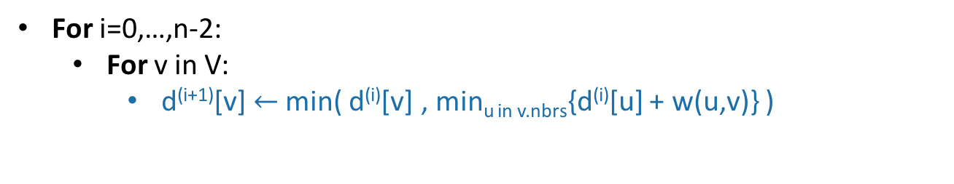
Negative cycles
Gates
Gates Packard CS161 Union Dish
d⁽⁰⁾
1
0
$$∞$$
$$∞$$
$$∞$$
$$∞$$
CS161
d⁽¹⁾
0
1
$$∞$$
$$∞$$
-3
1
d⁽²⁾
0
-5
2
7
-3
Packard
4
d⁽³⁾
-4
-5
-4
6
-3
d⁽⁴⁾
-4
-5
-4
6
-7
-2
Union
This is not looking good!
-3
10
For i=0,…,n-2:
For v in V:
d^{(i+1)}[v] $←$min( d^{(i)}[v] , min_{u in v.nbrs}{d^{(i)}[u] + w(u,v)} )
Dish

Slide 27

Negative edge weights
Gates
Gates Packard CS161 Union Dish
d⁽⁰⁾
1
0
$$∞$$
$$∞$$
$$∞$$
$$∞$$
CS161
d⁽¹⁾
0
1
$$∞$$
$$∞$$
-3
1
d⁽²⁾
0
-5
2
7
-3
Packard
4
d⁽³⁾
-4
-5
-4
6
-3
d⁽⁴⁾
-4
-5
-4
6
-7
-2
Union
But we can tell that it’s not looking good:
d⁽⁵⁾
-4
-9
-4
3
-3
-7
10
Some stuff changed!
For i=0,…,n-2:
For v in V:
d^{(i+1)}[v] $←$min( d^{(i)}[v] , min_{u in v.nbrs}{d^{(i)}[u] + w(u,v)} )
Dish

Slide 28
Negative cycles in Bellman-Ford
If there are no negative cycles:
Everything works as it should, and stabilizes.
If there are negative cycles:
Not everything works as it should…
Note: it couldn’t possibly work, since shortest paths aren’t well-defined if there are negative cycles.
The d[v] values will keep changing.
Solution:
Go one round more and see if things change.

Slide 29
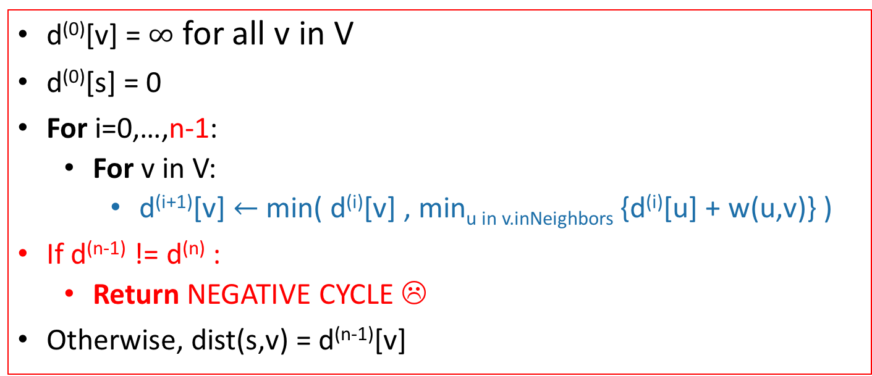
Bellman-Ford algorithm
Bellman-Ford*(G,s):
d⁽⁰⁾[v] = $∞$ for all v in V
d⁽⁰⁾[s] = 0
For i=0,…,n-1:
For v in V:
d^{(i+1)}[v] $←$min( d^{(i)}[v] , min_{u in v.inNeighbors} {d^{(i)}[u] + w(u,v)} )
If d^{(n-1)} != d^{(n)} :
Return NEGATIVE CYCLE ☹
Otherwise, dist(s,v) = d^{(n-1)}[v]
Running time: O(mn)

Slide 30
Important thing about B-F for the rest of this lecture
Gates
0
$$2$$
1
d^{(i)}[v] is equal to the cost of the shortest path between s and v with at most i edges.
CS161
1
Packard
Gates Packard CS161 Union Dish
$$1$$
4
d⁽⁰⁾
0
$$∞$$
$$∞$$
$$∞$$
$$∞$$
22
$$6$$
d⁽¹⁾
0
1
$$∞$$
$$∞$$
25
Union
d⁽²⁾
0
1
2
45
23
25
d⁽³⁾
0
1
2
6
23
20
d⁽⁴⁾
0
1
2
6
23
Dish
$$23$$

Slide 31
Bellman-Ford is an example of… Dynamic Programming!
Today:
Example of Dynamic programming:
Fibonacci numbers.
(And Bellman-Ford)
What is dynamic programming, exactly?
And why is it called “dynamic programming”?
Another example: Floyd-Warshall algorithm
An “all-pairs” shortest path algorithm

Slide 32
Pre-Lecture exercise: How not to compute Fibonacci Numbers
Definition:
F(n) = F(n-1) + F(n-2), with F(0) = F(1) = 1.
The first several are:
1
1
2
3
5
8
13, 21, 34, 55, 89, 144,…
Question:
Given n, what is F(n)?

Slide 33
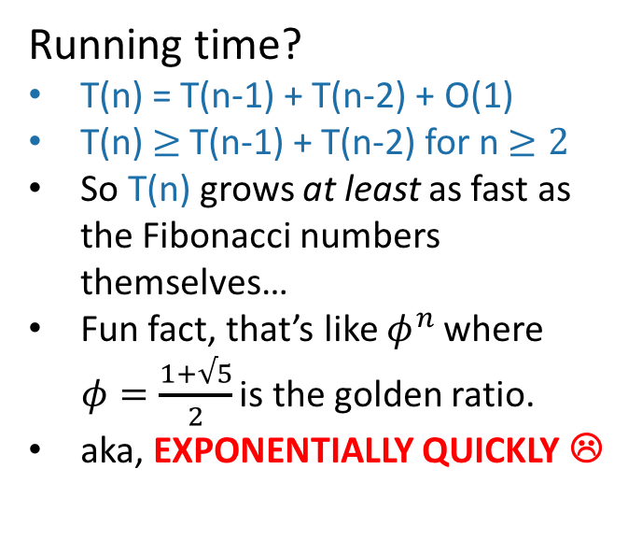
Candidate algorithm
See CLRS Problem 4-4 for a walkthrough of how fast the Fibonacci numbers grow!
def Fibonacci(n):
if n == 0 or n == 1:
return 1
return Fibonacci(n-1) + Fibonacci(n-2)
Running time?
T(n) = T(n-1) + T(n-2) + O(1)
T(n) $≥$T(n-1) + T(n-2) for n $≥2$
So T(n) grows at least as fast as the Fibonacci numbers themselves…
Fun fact, that’s like $φ^{n}$ where $φ=\frac{1+√5}{2}$ is the golden ratio.
aka, EXPONENTIALLY QUICKLY ☹
See IPython notebook for lecture 12

Slide 34
What’s going on? Consider Fib(8)
That’s a lot of repeated computation!
8
6
7
4
5
5
6
2
3
3
4
3
4
4
5
0
1
1
2
1
2
2
3
1
2
2
3
2
3
3
4
1
2
2
etc
0
1
0
1
0
1
1
2
0
1
0
1
0
1
1
1
2
0
1
0
1
0
1
0
1

Slide 35
Maybe this would be better:
8
def fasterFibonacci(n):
F = [1, 1, None, None, …, None ]
\\ F has length n + 1
for i = 2, …, n:
F[i] = F[i-1] + F[i-2]
return F[n]
7
6
Much better running time!
5
4
3
2
1
0

Slide 36
This was an example of…
Dynamic
Programming!

Slide 37
What is dynamic programming?
It is an algorithm design paradigm
like divide-and-conquer is an algorithm design paradigm.
Usually it is for solving optimization problems
eg, shortest path
(Fibonacci numbers aren’t an optimization problem, but they are a good example…)

Slide 38
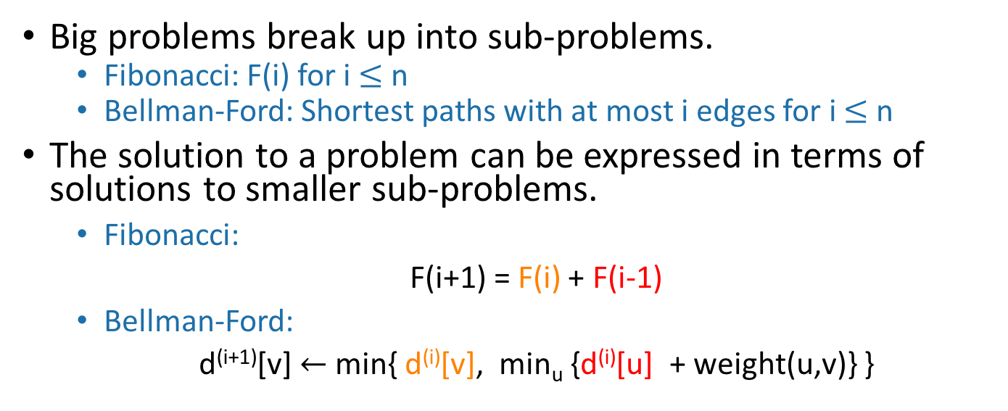
Elements of dynamic programming
1. Optimal sub-structure:
Big problems break up into sub-problems.
Fibonacci: F(i) for i $≤$ n
Bellman-Ford: Shortest paths with at most i edges for i $≤$ n
The solution to a problem can be expressed in terms of solutions to smaller sub-problems.
Fibonacci:
F(i+1) = F(i) + F(i-1)
Bellman-Ford:
d^{(i+1)}[v] $←$ min{ d^{(i)}[v], min_{u} {d^{(i)}[u] + weight(u,v)} }
Shortest path with at most i edges from s to v
Shortest path with at most i edges from s to u.

Slide 39
Elements of dynamic programming
2. Overlapping sub-problems:
The sub-problems overlap.
Fibonacci:
Both F[i+1] and F[i+2] directly use F[i].
And lots of different F[i+x] indirectly use F[i].
Bellman-Ford:
Many different entries of d^{(i+1)} will directly use d^{(i)}[v].
And lots of different entries of d^{(i+x)} will indirectly use d^{(i)}[v].
This means that we can save time by solving a sub-problem just once and storing the answer.

Slide 40
Elements of dynamic programming
Optimal substructure.
Optimal solutions to sub-problems can be used to find the optimal solution of the original problem.
Overlapping subproblems.
The subproblems show up again and again
Using these properties, we can design a dynamic programming algorithm:
Keep a table of solutions to the smaller problems.
Use the solutions in the table to solve bigger problems.
At the end we can use information we collected along the way to find the solution to the whole thing.

Slide 41
Two ways to think about and/or implement DP algorithms
Top down
Bottom up
This picture isn’t hugely relevant but I like it.

Slide 42
Bottom up approach what we just saw.
For Fibonacci:
Solve the small problems first
fill in F[0],F[1]
Then bigger problems
fill in F[2]
…
Then bigger problems
fill in F[n-1]
Then finally solve the real problem.
fill in F[n]

Slide 43
Bottom up approach what we just saw.
For Bellman-Ford:
Solve the small problems first
fill in d⁽⁰⁾
Then bigger problems
fill in d⁽¹⁾
…
Then bigger problems
fill in d^{(n-2)}
Then finally solve the real problem.
fill in d^{(n-1)}

Slide 44
Top down approach
Think of it like a recursive algorithm.
To solve the big problem:
Recurse to solve smaller problems
Those recurse to solve smaller problems
etc..
The difference from divide and conquer:
Keep track of what small problems you’ve already solved to prevent re-solving the same problem twice.
Aka, “memo-ization”

Slide 45
Example of top-down Fibonacci
define a global list F = [1,1,None, None, …, None]
def Fibonacci(n):
if F[n] != None:
return F[n]
else:
F[n] = Fibonacci(n-1) + Fibonacci(n-2)
return F[n]
Memo-ization: Keeps track (in F) of the stuff you’ve already done.

Slide 46
Memo-ization visualization
Collapse repeated nodes and don’t do the same work twice!
8
6
7
4
5
5
6
2
3
3
4
3
4
4
5
0
1
1
2
1
2
2
3
1
2
2
3
2
3
3
4
1
2
2
etc
0
1
0
1
0
1
1
2
0
1
0
1
0
1
1
1
2
0
1
0
1
0
1
0
1

Slide 47
Memo-ization Visualization ctd
8
7
Collapse repeated nodes and don’t do the same work twice!
But otherwise treat it like the same old recursive algorithm.
6
5
4
define a global list F = [1,1,None, None, …, None]
def Fibonacci(n):
if F[n] != None:
return F[n]
else:
F[n] = Fibonacci(n-1) + Fibonacci(n-2)
return F[n]
3
2
1
0

Slide 48
What have we learned?
Dynamic programming:
Paradigm in algorithm design.
Uses optimal substructure
Uses overlapping subproblems
Can be implemented bottom-up or top-down.
It’s a fancy name for a pretty common-sense idea:
Don’t duplicate work if you don’t have to!

Slide 49
Why “dynamic programming” ?
Programming refers to finding the optimal “program.”
as in, a shortest route is a plan aka a program.
Dynamic refers to the fact that it’s multi-stage.
But also it’s just a fancy-sounding name.
Manipulating computer code in an action movie?

Slide 50
Why “dynamic programming” ?
Richard Bellman invented the name in the 1950’s.
At the time, he was working for the RAND Corporation, which was basically working for the Air Force, and government projects needed flashy names to get funded.
From Bellman’s autobiography:
“It’s impossible to use the word, dynamic, in the pejorative sense…I thought dynamic programming was a good name. It was something not even a Congressman could object to.”

Slide 51
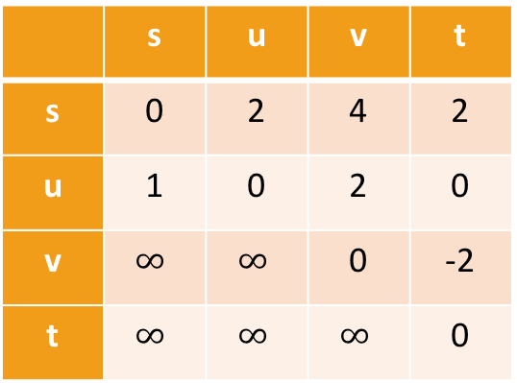
Floyd-Warshall Algorithm Another example of DP
This is an algorithm for All-Pairs Shortest Paths (APSP)
That is, I want to know the shortest path from u to v for ALL pairs u,v of vertices in the graph.
Not just from a special single source s.
Destination
Source
 | s | u | v | t
s | 0 | 2 | 4 | 2
u | 1 | 0 | 2 | 0
v | $$∞$$ | $$∞$$ | 0 | -2
t | $$∞$$ | $$∞$$ | $$∞$$ | 0
s
2
u
1
5
2
t
v
-2

Slide 52
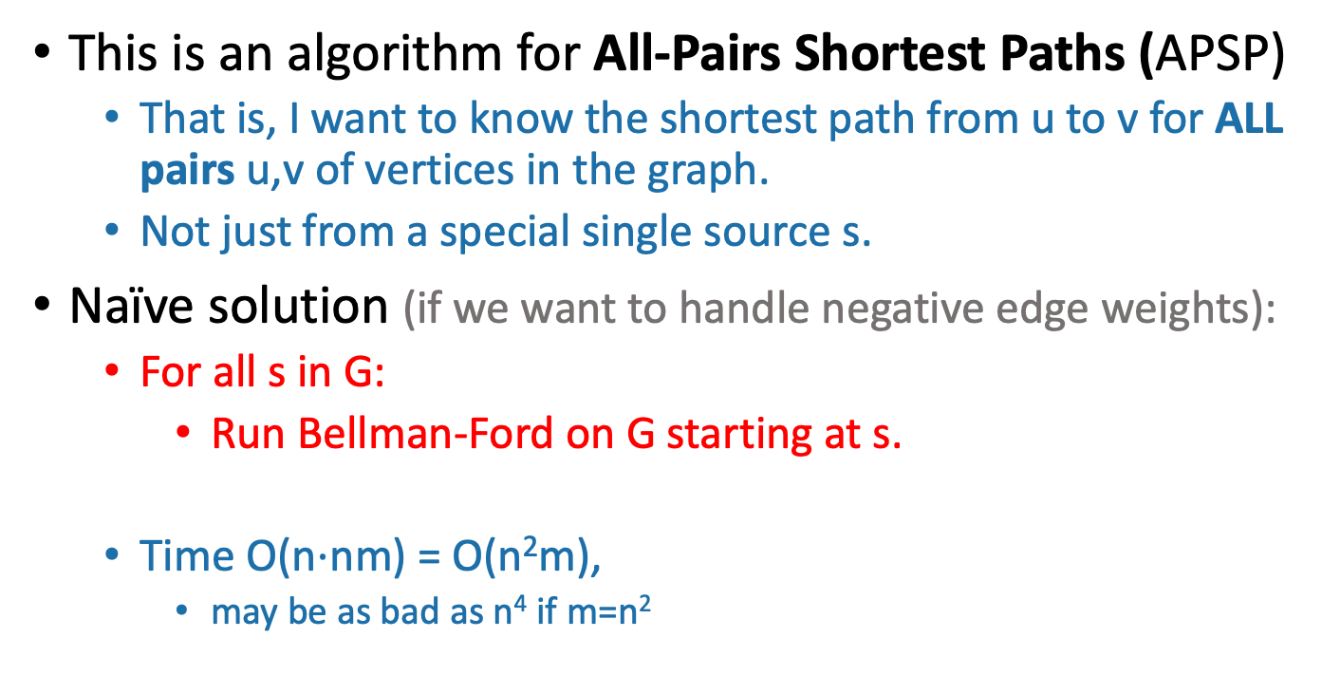
Floyd-Warshall Algorithm Another example of DP
This is an algorithm for All-Pairs Shortest Paths (APSP)
That is, I want to know the shortest path from u to v for ALL pairs u,v of vertices in the graph.
Not just from a special single source s.
Naïve solution (if we want to handle negative edge weights):
For all s in G:
Run Bellman-Ford on G starting at s.
Time O(n$⋅$nm) = O(n²m),
may be as bad as n⁴ if m=n²
Can we do better?

Slide 53
Optimal substructure
Label the vertices 1,2,…,n
k
k+1
u
1
2
v
3
…
k-1
n

Slide 54
Optimal substructure
Label the vertices 1,2,…,n
(We omit some edges in the picture below – meant to be a cartoon, not an example).
Sub-problem(k-1):
For all pairs, u,v, find the cost of the shortest path from u to v, so that all the internal vertices on that path are in {1,…,k-1}.
Our DP algorithm will fill in the
n-by-n arrays
D⁽⁰⁾, D⁽¹⁾, …, D^{(n)} iteratively and then we’ll be done.
k
Let D^{(k-1)}[u,v] be the solution to Sub-problem(k-1).
k+1
u
1
2
v
3
…
k-1
This is the shortest path from u to v through the blue set. It has cost D^{(k-1)}[u,v]
n
Vertices 1, …, k-1

Slide 55
Optimal substructure
Label the vertices 1,2,…,n
(We omit some edges in the picture below – meant to be a cartoon, not an example).
Sub-problem(k-1):
For all pairs, u,v, find the cost of the shortest path from u to v, so that all the internal vertices on that path are in {1,…,k-1}.
Our DP algorithm will fill in the
n-by-n arrays
D⁽⁰⁾, D⁽¹⁾, …, D^{(n)} iteratively and then we’ll be done.
k
Let D^{(k-1)}[u,v] be the solution to Sub-problem(k-1).
k+1
Question: How can we find D^{(k)}[u,v] using D^{(k-1)}?
u
1
2
v
3
…
k-1
This is the shortest path from u to v through the blue set. It has length D^{(k-1)}[u,v]
n
Vertices 1, …, k-1

Slide 56
How can we find D^{(k)}[u,v] using D^{(k-1)}?
D^{(k)}[u,v] is the cost of the shortest path from u to v so that all internal vertices on that path are in {1, …, k}.
k
k+1
Vertices 1, …, k
u
1
2
v
3
…
k-1
n
Vertices 1, …, k-1

Slide 57
How can we find D^{(k)}[u,v] using D^{(k-1)}?
D^{(k)}[u,v] is the cost of the shortest path from u to v so that all internal vertices on that path are in {1, …, k}.
Case 1: we don’t need vertex k.
k
k+1
Vertices 1, …, k
u
1
2
v
3
…
k-1
This path was the shortest before, so it’s still the shortest now.
n
Vertices 1, …, k-1
D^{(k)}[u,v] = D^{(k-1)}[u,v]

Slide 58
How can we find D^{(k)}[u,v] using D^{(k-1)}?
D^{(k)}[u,v] is the cost of the shortest path from u to v so that all internal vertices on that path are in {1, …, k}.
Case 2: we need vertex k.
k
k+1
Vertices 1, …, k
u
1
2
v
3
…
k-1
n
Vertices 1, …, k-1

Slide 59
Case 2 continued
Suppose there are no negative cycles.
Then WLOG the shortest path from u to v through {1,…,k} is simple.
If that path passes through k, it must look like this:
This path is the shortest path from u to k through {1,…,k-1}.
sub-paths of shortest paths are shortest paths
Similarly for this path.
Case 2: we need vertex k.
k
Vertices 1, …, k
u
1
2
v
3
…
k-1
n
Vertices 1, …, k-1
D^{(k)}[u,v] = D^{(k-1)}[u,k] + D^{(k-1)}[k,v]

Slide 60
How can we find D^{(k)}[u,v] using D^{(k-1)}?
Case 1: we don’t need vertex k.
Case 2: we need vertex k.
k
k
Vertices 1, …, k
Vertices 1, …, k
u
1
u
1
2
2
v
v
3
3
…
…
k-1
k-1
Vertices 1, …, k-1
Vertices 1, …, k-1
D^{(k)}[u,v] = D^{(k-1)}[u,v]
D^{(k)}[u,v] = D^{(k-1)}[u,k] + D^{(k-1)}[k,v]

Slide 61
How can we find D^{(k)}[u,v] using D^{(k-1)}?
D^{(k)}[u,v] = min{ D^{(k-1)}[u,v], D^{(k-1)}[u,k] + D^{(k-1)}[k,v] }
Optimal substructure:
We can solve the big problem using solutions to smaller problems.
Overlapping sub-problems:
D^{(k-1)}[k,v] can be used to help compute D^{(k)}[u,v] for lots of different u’s.
Case 1: Cost of shortest path through {1,…,k-1}
Case 2: Cost of shortest path from u to k and then from k to v through {1,…,k-1}

Slide 62
How can we find D^{(k)}[u,v] using D^{(k-1)}?
D^{(k)}[u,v] = min{ D^{(k-1)}[u,v], D^{(k-1)}[u,k] + D^{(k-1)}[k,v] }
Using our Dynamic programming paradigm, this immediately gives us an algorithm!
Case 1: Cost of shortest path through {1,…,k-1}
Case 2: Cost of shortest path from u to k and then from k to v through {1,…,k-1}

Slide 63
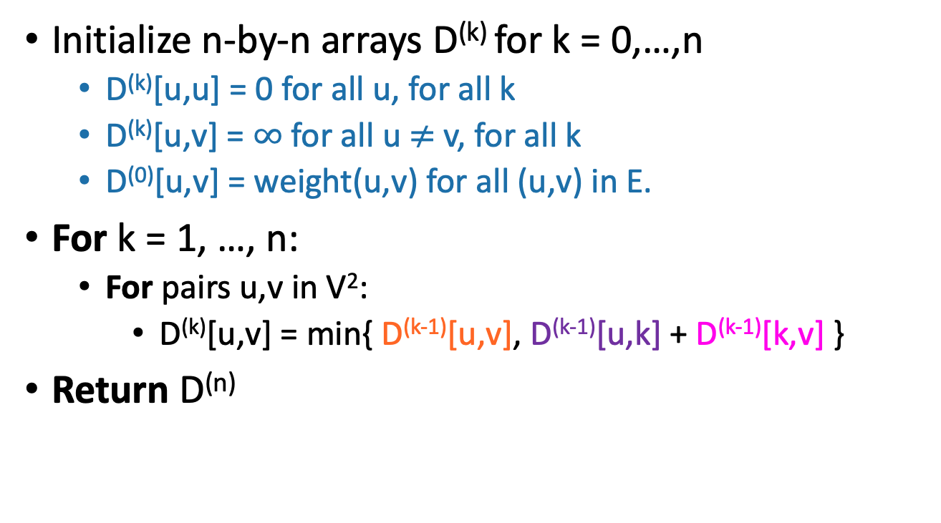
Floyd-Warshall algorithm
Initialize n-by-n arrays D^{(k)} for k = 0,…,n
D^{(k)}[u,u] = 0 for all u, for all k
D^{(k)}[u,v] = $∞$ for all u $≠$ v, for all k
D⁽⁰⁾[u,v] = weight(u,v) for all (u,v) in E.
For k = 1, …, n:
For pairs u,v in V²:
D^{(k)}[u,v] = min{ D^{(k-1)}[u,v], D^{(k-1)}[u,k] + D^{(k-1)}[k,v] }
Return D^{(n)}
The base case checks out: the only path through zero other vertices are edges directly from u to v.
This is a bottom-up Dynamic programming algorithm.

Slide 64
We’ve basically just shown
Theorem:
If there are no negative cycles in a weighted directed graph G, then the Floyd-Warshall algorithm, running on G, returns a matrix D^{(n)} so that:
D^{(n)}[u,v] = distance between u and v in G.
Running time: O(n³)
Better than running Bellman-Ford n times!
Storage:
Need to store two n-by-n arrays, and the original graph.
Work out the details of a proof!
As with Bellman-Ford, we don’t really need to store all n of the D^{(k)}.

Slide 65
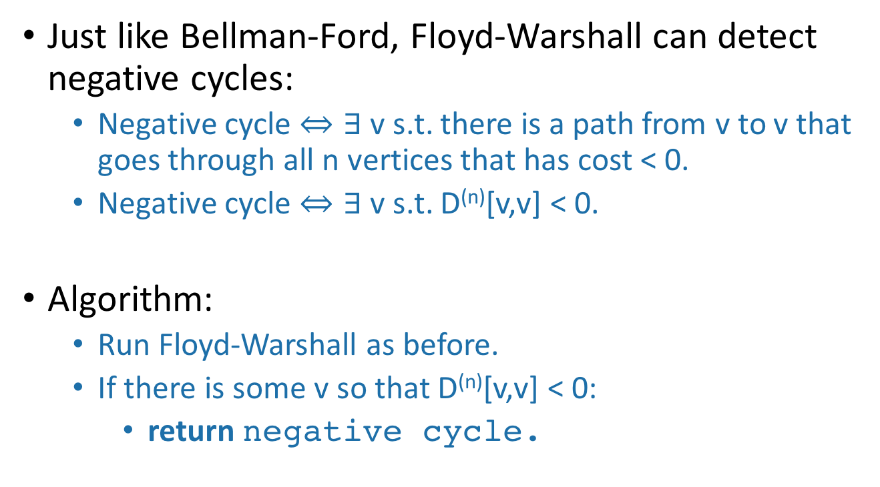
What if there are negative cycles?
Just like Bellman-Ford, Floyd-Warshall can detect negative cycles:
Negative cycle $⇔∃$ v s.t. there is a path from v to v that goes through all n vertices that has cost < 0.
Negative cycle $⇔∃$ v s.t. D^{(n)}[v,v] < 0.
Algorithm:
Run Floyd-Warshall as before.
If there is some v so that D^{(n)}[v,v] < 0:
return negative cycle.

Slide 66
What have we learned?
The Floyd-Warshall algorithm is another example of dynamic programming.
It computes All Pairs Shortest Paths in a directed weighted graph in time O(n³).

Slide 67
Bonus: Another Example of DP?
This slide probably skipped in class
Longest simple path (say all edge weights are 1):
s
a
t
b
What is the longest simple path from s to t?

Slide 68
This is an optimization problem…
This slide probably skipped in class
Can we use Dynamic Programming?
Optimal Substructure?
Longest path from s to t = longest path from s to a
+ longest path from a to t?
s
a
NOPE!
t
b

Slide 69
This doesn’t give optimal sub-structure Optimal solutions to subproblems don’t give us an optimal solution to the big problem. (At least if we try to do it this way).
The sub-problems we came up with aren’t independent:
Once we’ve chosen the longest path from a to t
which uses b,
our longest path from s to a shouldn’t be allowed to use b
since b was already used and that breaks the “simple-ness” of the combined path.
Actually, the longest simple path problem is NP-complete.
We don’t know of any polynomial-time algorithms for it, DP or otherwise!
s
a
t
b
This slide probably skipped in class

Slide 70
Recap
Two shortest-path algorithms:
Bellman-Ford for single-source shortest path
Floyd-Warshall for all-pairs shortest path
Dynamic programming!
This is a fancy name for:
Break up an optimization problem into smaller problems
The optimal solutions to the sub-problems should be sub-solutions to the original problem.
Build the optimal solution iteratively by filling in a table of sub-solutions.
Take advantage of overlapping sub-problems!

Slide 71
Next time
More examples of dynamic programming!
We will stop bullets with our action-packed coding skills, and also maybe find longest common subsequences.

